Slide 1
Unlocking Homeownership
- A COMPREHENSIVE GUIDE FOR FIRST-TIME BUYERS -

Slide 2
Did You Know…
TOP 5 First Steps Taken During The Home Buying Process 2022
47% Looked Online for Properties for Sale
18% Contacted a Real Estate Agent
8% Looked For Information Online About the Home Buying Process
9% Contacted a Bank or Mortgage Lender
7% Talked with a Friend/Relative About Home Buying Process
Only 9%
Of all homebuyers in 2022 began the home buying process by contacting a bank or mortgage lender.
**Information provided by the 2023 NAR Home Buyers and Sellers Generational Trends report

Slide 3
START WITH A
Pre-Qualification
A pre-qualification is an essential first step in the home buying process as it shows you have the financial ability to bid on a property and secure a mortgage.
Additional benefits include:
Initial estimate of the amount you can borrow
Requires a credit check
Competitive advantage over other buyers
READY TO BUY?
Get Pre-Approved!
In a competitive market, it’s important
to make your offer stand out. GRB’s
pre-approvals are fully underwritten
with a mortgage commitment.
Programs available for a
GRB Pre-Approval include:
FHA
VA
USDA
Conventional
Portfolio

Slide 4
Home Mortgage Lending For Every Stage
Whether you need a refinance or first mortgage or want to finance a second home or investment property, GRB has a lending solution to fit your needs. GRB’s major lending programs include:
First-time Buyers, Grants, & Other Programs
Cash+ Mortgage Programs Cash+Guarantee, Cash+Mortgage
Government Loan Programs (FHA, VA, USDA, SONYMA)
RateRelief+ Buy With Confidence, Refinance With Ease
Conventional Loans, Buydowns, and Refinancing
Specialty Lending Options (Jumbo, Construction, Investor, Portfolio)

Slide 5
Why GRB?
GRB serves as a knowledgeable, trusted advisor to its customers – providing proactive, strategic counsel, unmatched personal service, and access to the resources local residents need to succeed.
GRB has lending options for every stage of homeownership. Whether you’re purchasing your first home, refinancing, investing or downsizing, GRB has a solution.
Our Services
GRB’s home mortgage options include traditional loan programs, as well as specialty lending options and local grants and discounts.
GRB’s mortgage and lending process is located all in one location – providing quick decision-making and turn-around times for YOU!
LOCAL Originating
LOCAL Processing
LOCAL Underwriting
LOCAL Closing/Post Closing

Slide 6
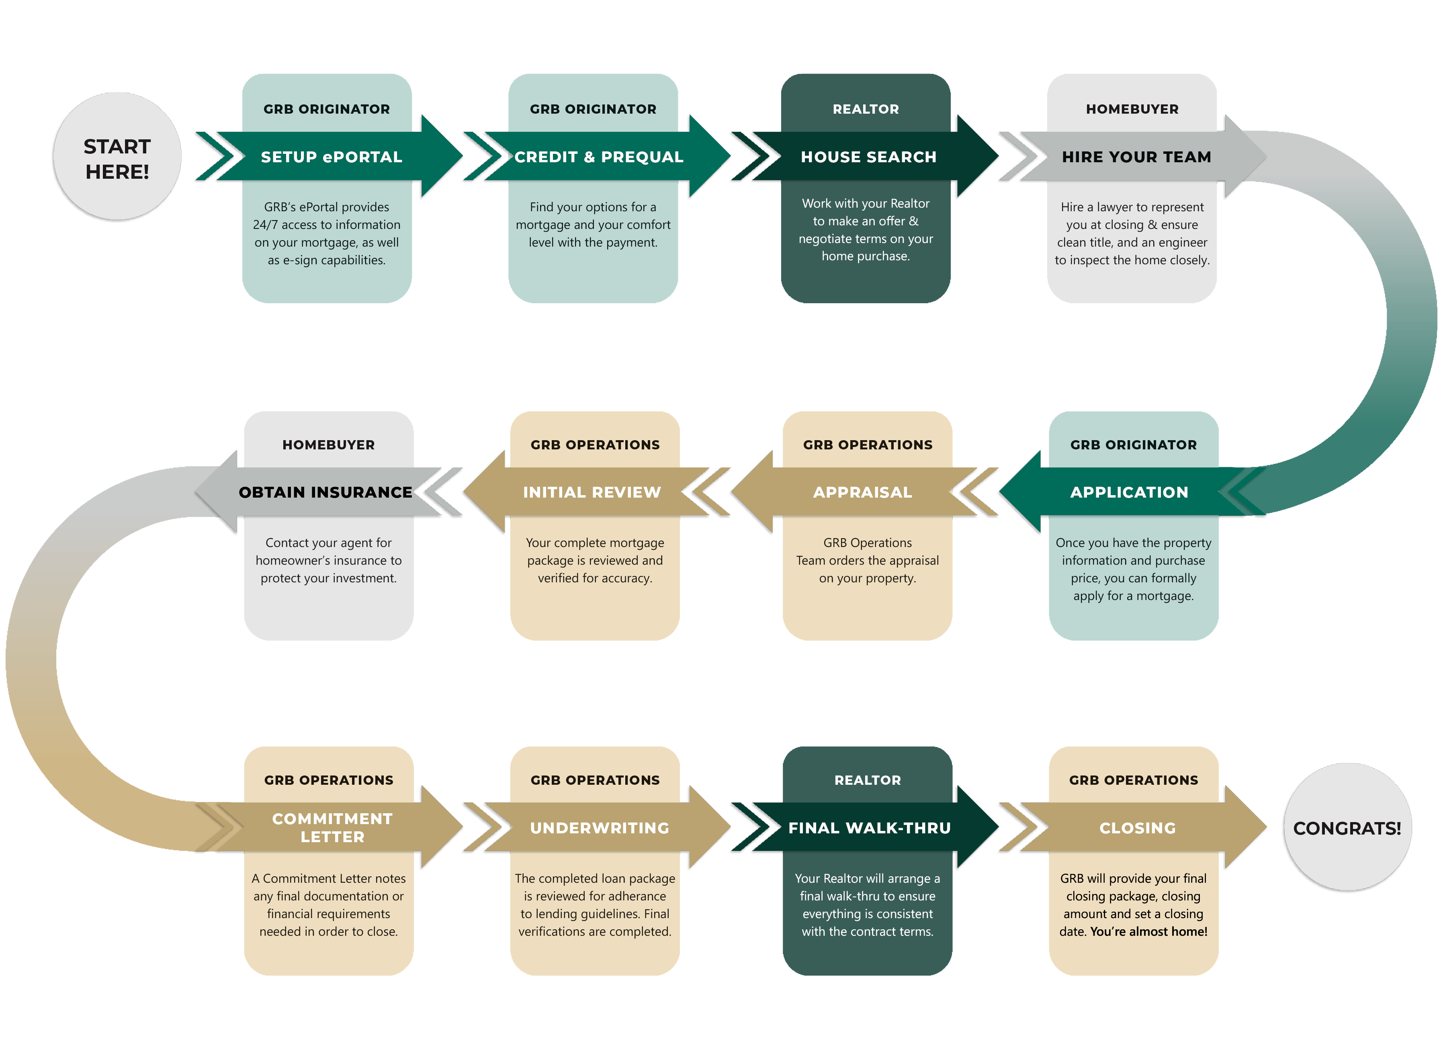
MORTGAGE PROCESS

Slide 7
Know the Terminology
During the home buying process, you may hear several terms or acronyms that don’t sound familiar.
Common terms you’ll hear include:
Down Payment
The difference between the
purchase price and mortgage amount.
Closing Costs
Costs payable by
both seller and buyer at the time of settlement, when the purchase of the property is finalized.
PITI
Abbreviation for principal, interest, taxes, and insurance.
PMI
Abbreviation for Private Mortgage Insurance – insurance paid by the borrower to guard against loss due to foreclosure or loan default on a financed home.

Slide 8
Available mortgage programs and
grants available to first-time
homebuyers through GRB include:
Homebuyer Dream Program
SONYMA Programs
City of Rochester HPAP
City of Rochester/RCSD EAHI
FIRST-TIME
Homebuyers
Offering down payment assistance programs
and local grant opportunities.

Slide 9
Through the 2024 Homebuyer Dream
Program, GRB was able to assist:
120
FIRST TIME HOMEBUYERS
Homebuyer
Dream Program©
The Homebuyer Dream Program© (HDP©) is a non-competitive
grant program offered to eligible first-time home buyers that
provides up to $20,000 on a first come, first serve basis.
More details for the 2025 Homebuyer Dream Program
will be available after December 10, 2024.

Slide 10
When a buyer presents a Cash+Guarantee offer from GRB to purchase a home, it means they have:
A completely underwritten loan. All financing contingencies have been removed.
A 20% or more earnest money deposit (EMD) with a Loan-to-Value up to 95%.
A guarantee from GRB that it will BUY THE HOUSE for the purchase offer amount if the buyer fails to complete the home purchase.*
* Some restrictions apply. Talk to a GRB Mortgage Originator for program details and to request a copy of GRB’s Cash+Guarantee agreement.
GRB’s Cash+Guarantee^{Tm} is the gold standard in residential mortgage lending. A Cash+Guarantee offer provides both buyers and sellers with peace of mind.

Slide 11
WELCOME HOME
Mortgage Credit
Buyers can earn up to a 1.00% credit on their mortgage loan amount when they open an account with GRB at the time of application.
WELCOME HOME
Mortgage Rewards
Buyers who close on their mortgage with GRB are eligible to earn up to $250 when they open a Mortgage Rewards account.
Welcome Home
BORROW SMARTER. BANK BETTER.
WELCOME HOME
Reward Checking
Buyers can continue to earn with premium interest rates on GRB checking account balances from $0.01 to $15,000.00 each calendar month.
GRB’s Welcome Home Relationship Reward Program
helps ease the financial burden of buying a home and reflects our commitment to fostering the long-term financial well-being of the individuals and families who call our region home.

Slide 12
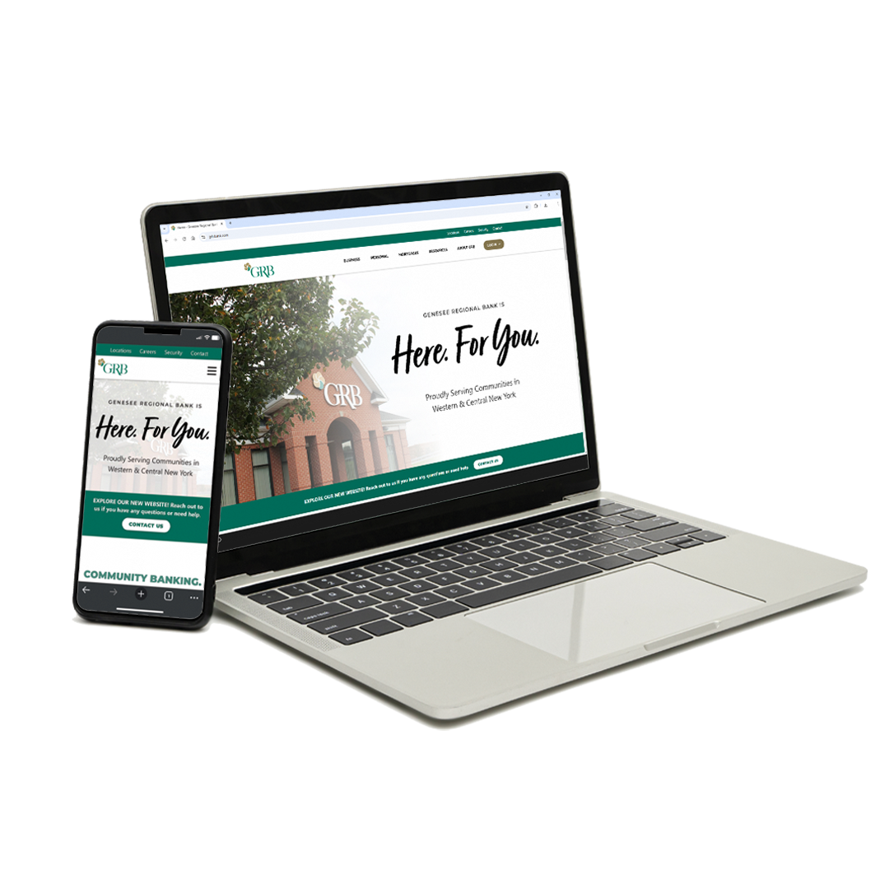
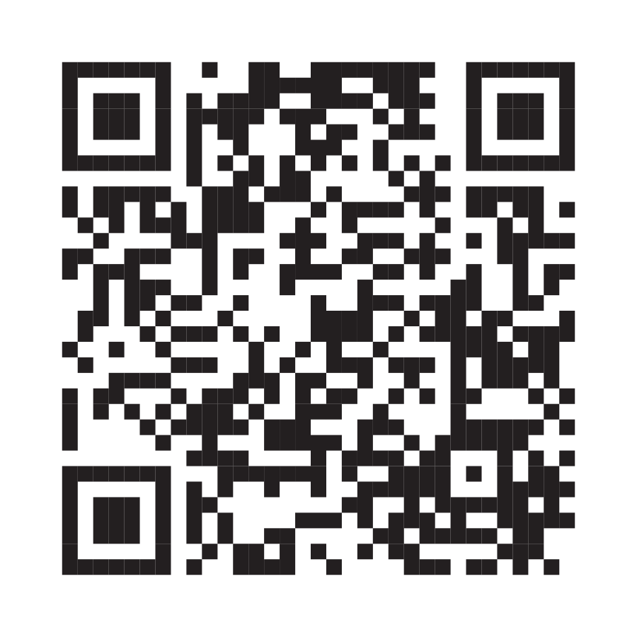
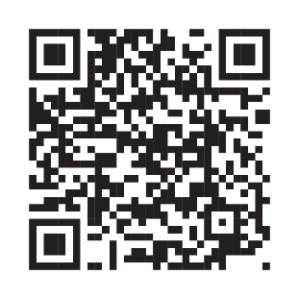
BUYER
RESOURCES
A page built with our borrowers
in mind with all the tools
and data you need to
succeed in today’s market!
MORTGAGE
PROGRAMS
A page dedicated to listing all
of our mortgage programs so buyers, sellers, and investors can easily sort through our programs!
VISIT US AT THE NEW
GRBbank.com

Slide 13
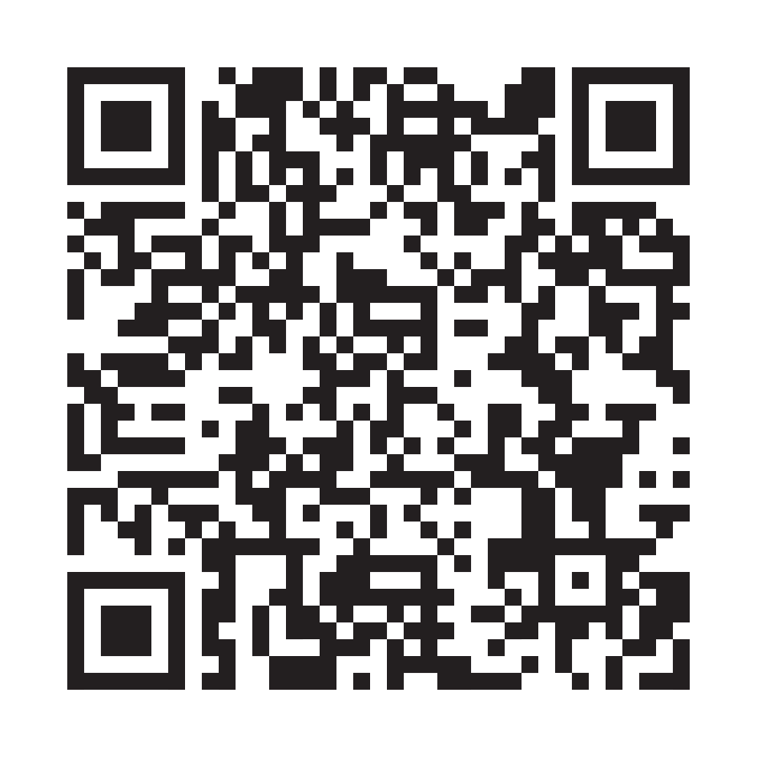
Ready To Buy?
Work with the team that’s prepared to make the process of obtaining a home mortgage as easy as possible!
Joe Leone
GVP, Residential Mortgage Manager
- NMLS#6780 -
585.478.0163
jaleone@grbbank.com
Mortgage & lending processes all under one roof
Access to local grants & discounts
Online & mobile app for a streamlined mortgage process
Get Started Today!
Scan the QR code to submit your information and I’ll be sure
to contact you.
Or save my contact information to call or email me!

Slide 14
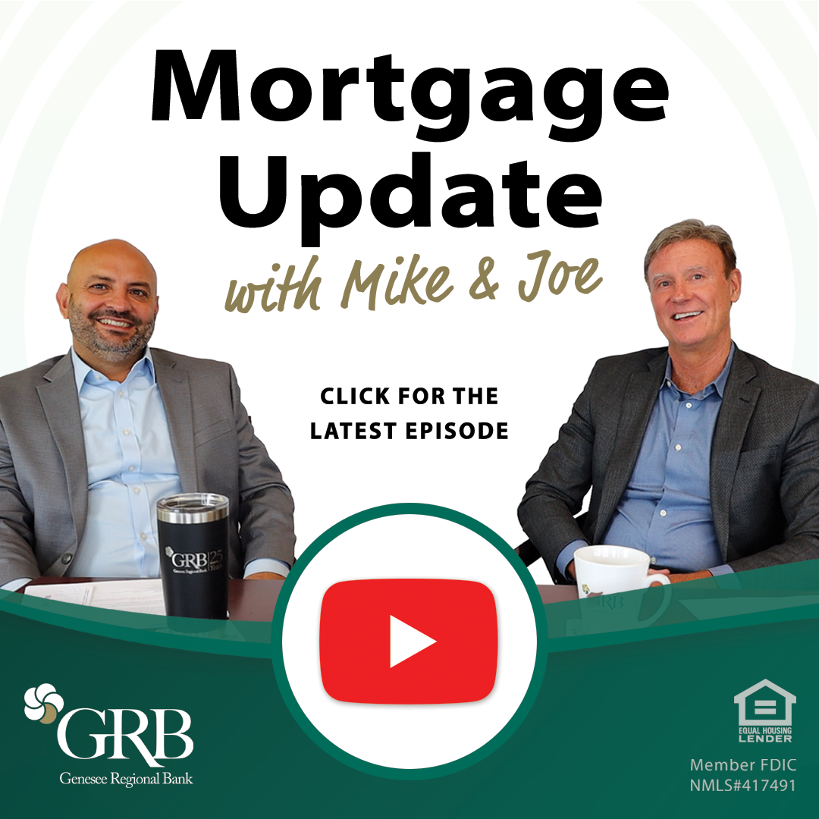
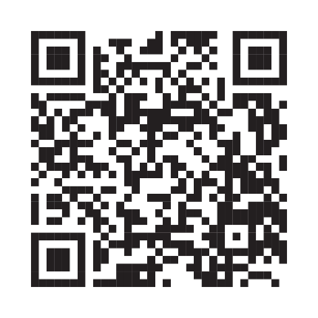
Want To Hear More?
Catch the Mortgage Update With Mike & Joe to learn about local
Housing market trends and news!
Visit: GRBbank.com/MJ
Or Scan the QR Code:

